Slide 1


Automate Data Lake with AWS Lake Formation

Slide 2





























Covering It All With Lake Formation
Amazon
Amazon Elasticsearch
AWS
Glue
AWS
AppSync
Amazon API Gateway
Amazon Cognito
DynamoDB Service
Access & User Interfaces
Catalog & Search
Central Storage
Scalable, secure, cost- effective
Amazon Athena
Amazon EMR
AWS
Glue
Amazon Redshift
Amazon DynamoDB
AWS
Snowball
Amazon Kinesis Data Firehose
AWS Direct Connect
AWS Database Migration Service
AWS Storage Gateway
S3
Manage & Secure
Amazon QuickSight
Amazon Kinesis
Amazon Elasticsearch Service
Amazon Neptune
Amazon RDS
AWS
DataSync
AWS Transfer for SFTP
Amazon S3 Transfer Acceleration
Analytics & Serving
AWS KMS
AWS IAM
AWS
CloudTrail
Amazon CloudWatch
Data Ingestion

Slide 3
Agenda
Lake Formation Value Proposition
AWS Lake Formation
Steps to build Data Lake
Reference Architecture
Lake Formation Console Walkthrough

Slide 4
What is hard about building data lakes?
Manually building secure data lakes is hard

Slide 5
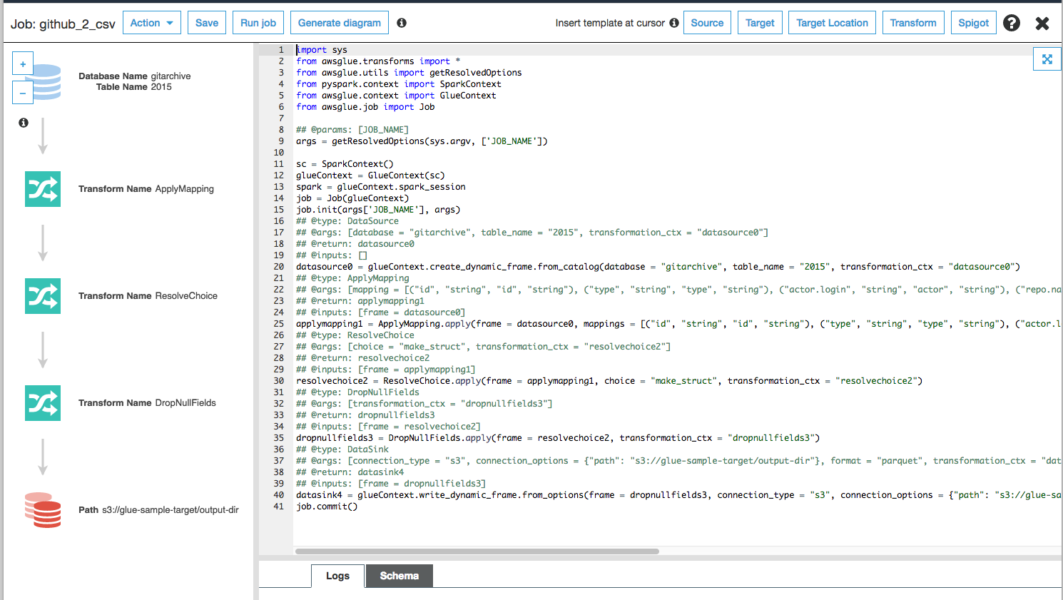
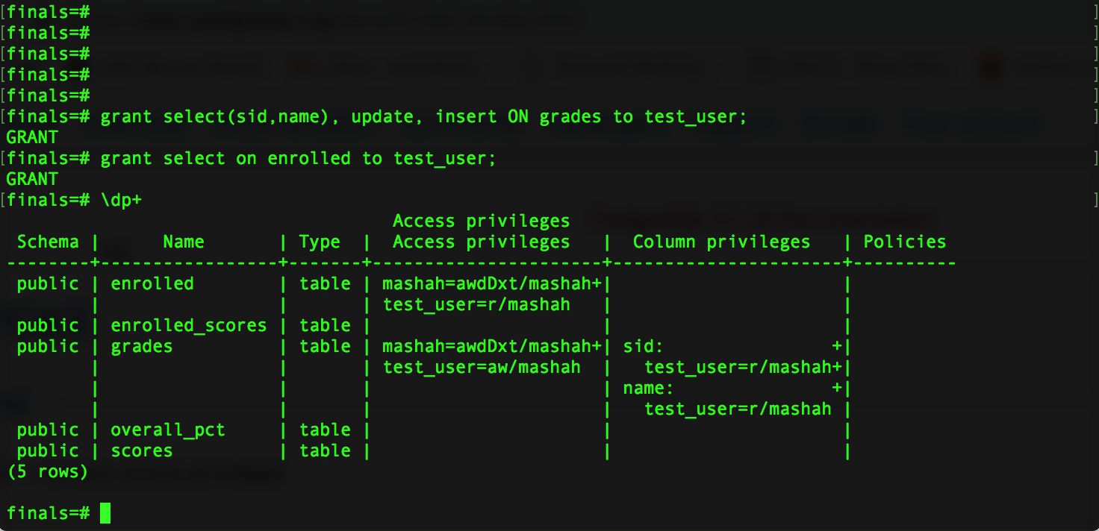
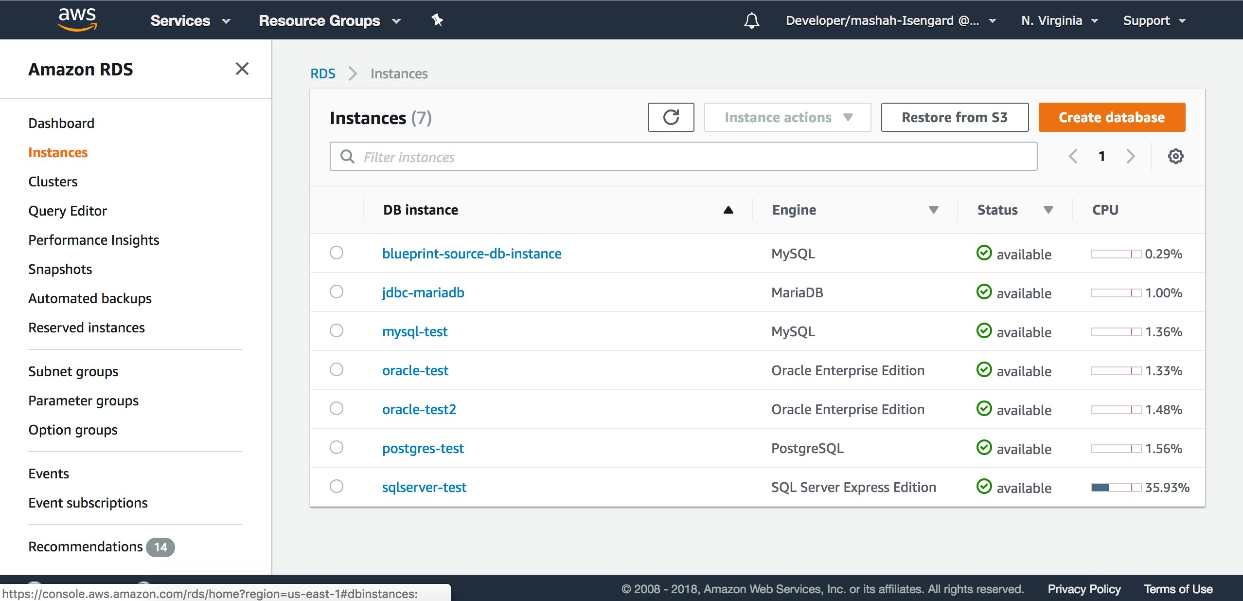
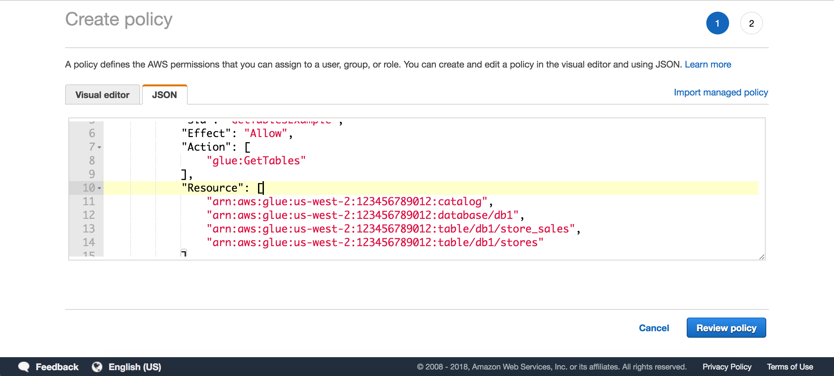
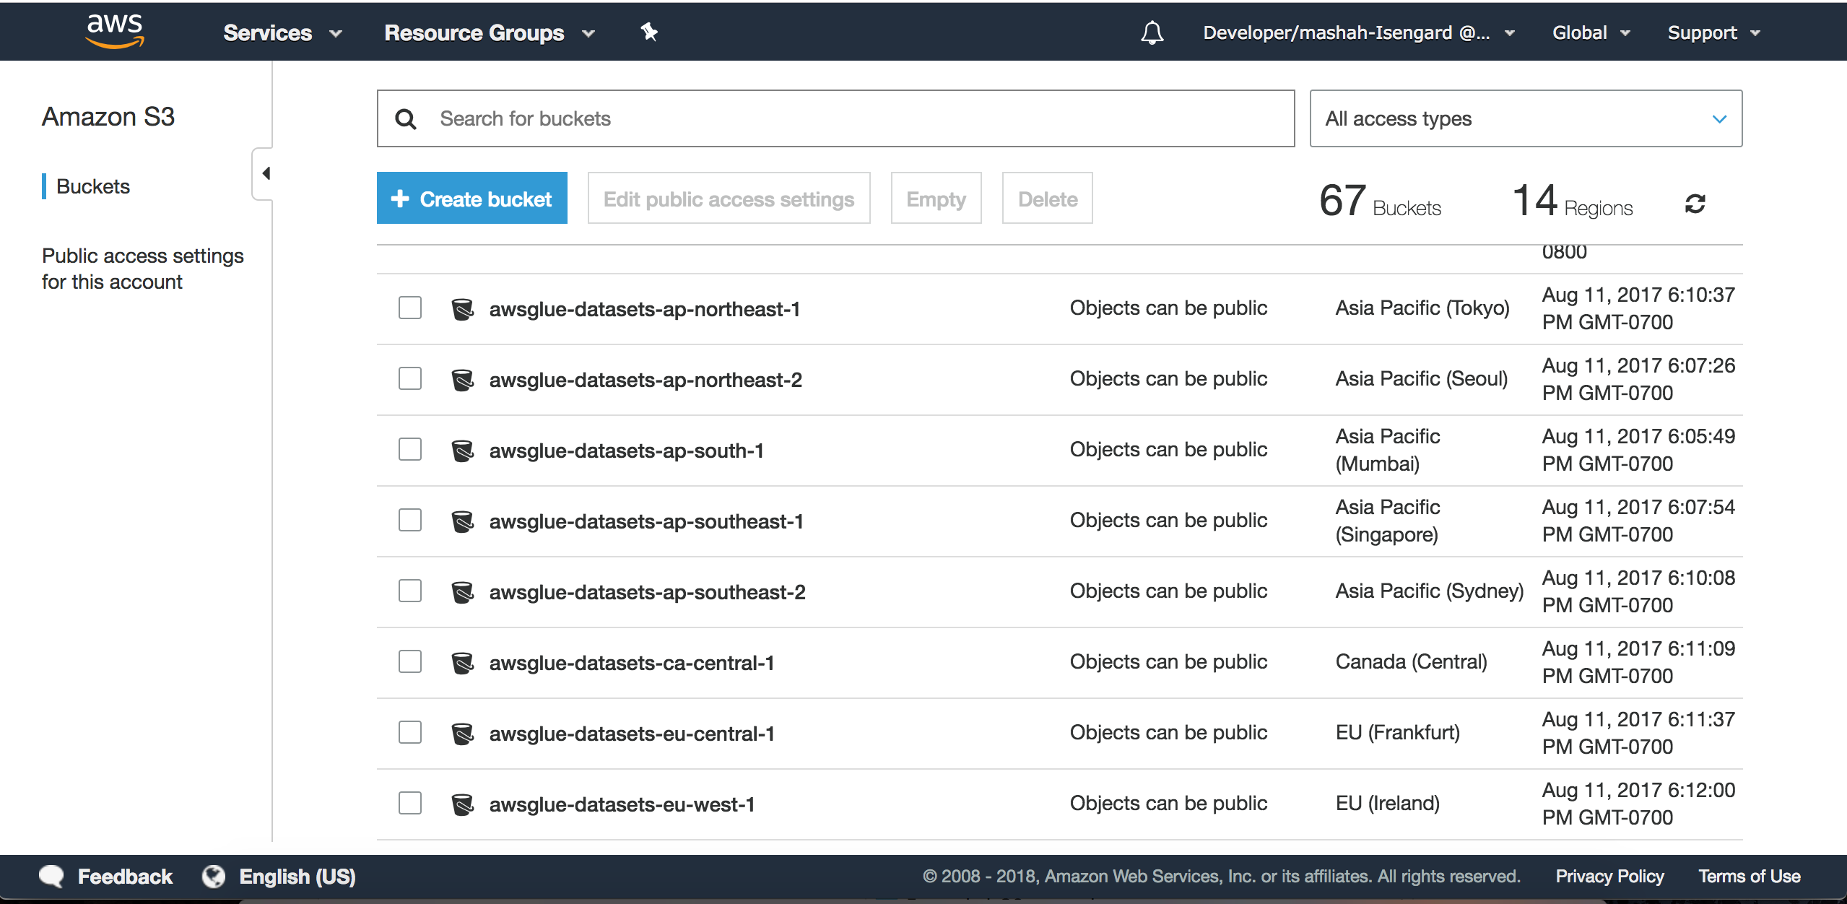
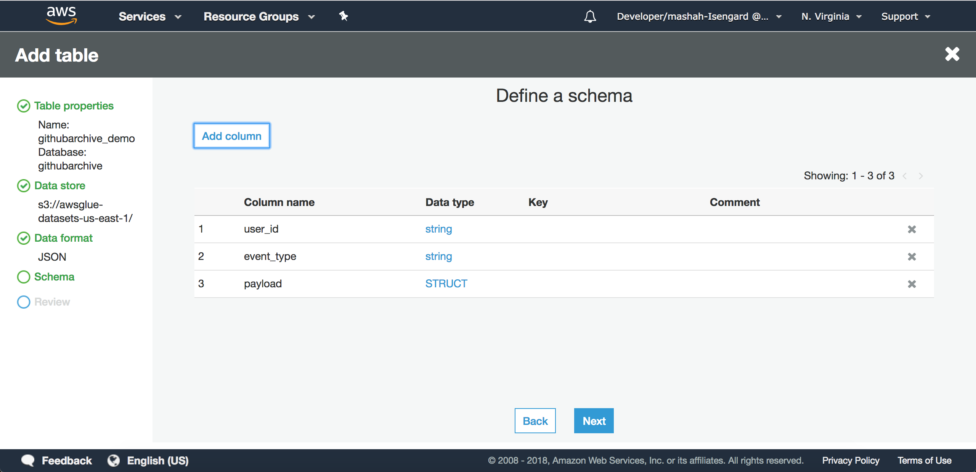
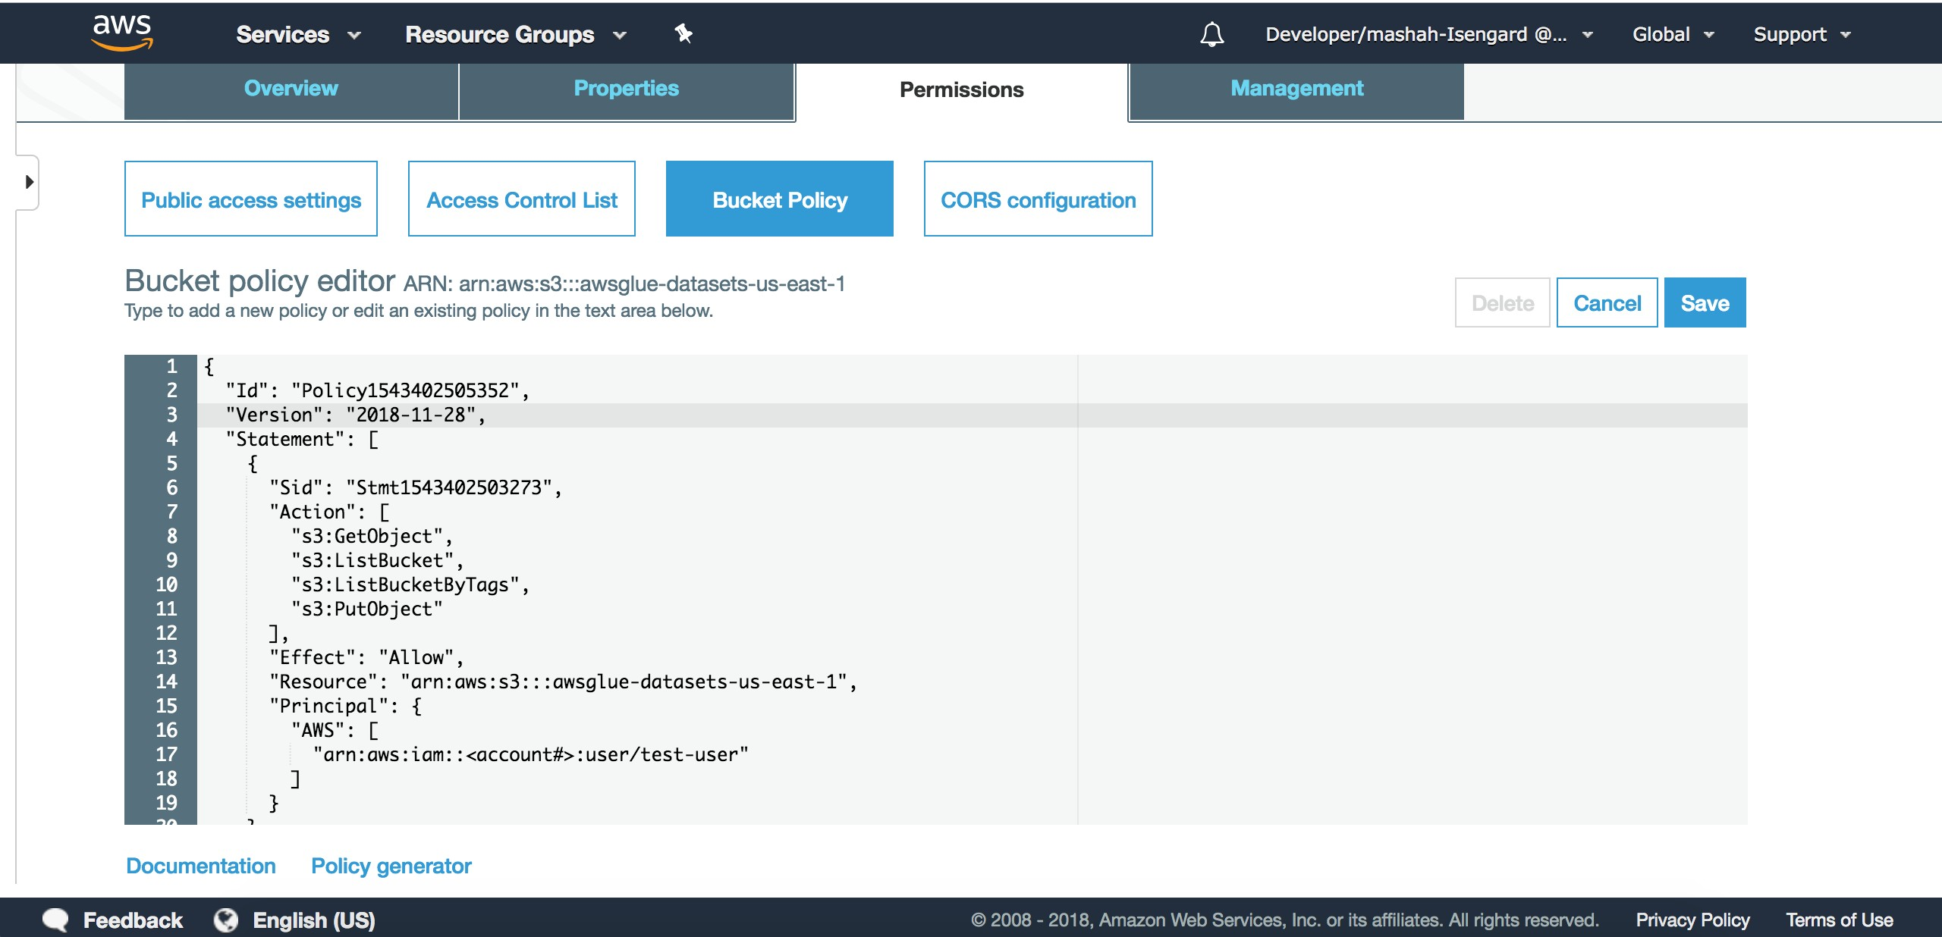
^{Sample of steps required} Configure access from analytics services
ETL jobs to load and clean data Find sources
Create Amazon Sim^{Ma}pl^{p}e St^{ta}o^{b}r^{les to Amazon S3 locations} cations
Create metadata access policies
Rinse and repeat for other:
data sets, users, and end-services
And more:
manage and monitor ETL jobs
update metadata catalog as data changes
update policies across services as users and permissions change manually maintain cleansing scripts
create audit processes for compliance
…
Manual | Error-prone | Time consuming
age Service (Amazon S3) lo
Configure access policies

Slide 6

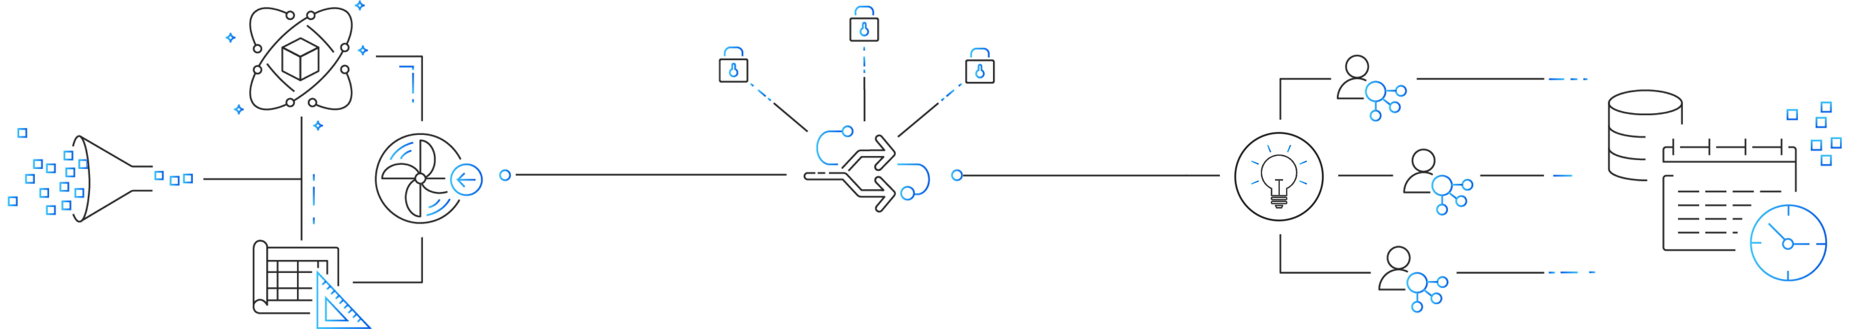



Typical steps of building a data lake
Ingestion & cleaning
Security
Analytics & ML
1
Setup storage
4
Configure and enforce security and compliance policies
2
Move data
5
Make data available for analytics
3
Cleanse, prep, and catalog data
D_{D}a_{a}t_{ta}a
Analyst
Data Engineer
Data Security Officer

Slide 7
What is Lake Formation?
Automating Data Lake

Slide 8










Features and Benefits of Lake Formation
Comprehensive set of integrated tools
enable every user equally
Amazon Athena
Amazon QuickSight
Amazon Redshift
Amazon SageMaker
Amazon EMR
Centralized management of fine grained permissions empower security officers
Lake Formation
AWS Glue
Blueprints
ML
Transforms
Data Catalog
Access
Control
Simplified ingest & cleaning enables data engineers to build faster
Amazon S3 Data Lake Storage
Cost effective, durable storage with global replication capabilities

Slide 9




Building data lakes with Lake Formation
Ingestion & cleaning
Security
Analytics & ML
Data
AWS Glue
Data catalog
Comprehensive portfolio of integrated tools
Serverless Spark
Centralized permissions
Blueprints
Real time monitoring
ML Transforms
Auditing

Slide 10






AWS Lake Formation is fully integrated w/ AWS Glue
AWS Lake Formation
Security, search, collaboration
Blueprints
Monitoring
Workflow
Glue Data Catalog
Glue ETL Jobs
Glue Crawlers
Connections, Databases, Tables
AWS Glue

Slide 11





AWS Glue Components (Recap)
Data Catalog
Serverless Engine
Orchestration
Discover
Automatic crawling
Apache Hive Metastore compatible Integrated with AWS analytic services
Develop
Apache Spark Python shell
Interactive and batch jobs
Deploy
Flexible workflows Monitoring and alerting External integrations

Slide 12











Easily load data into your data lake w/ blueprints
Prebuilt templates to serve common ingestion use cases
Amazon RDS
DBs
Automatically build AWS Glue workflows
Amazon Aurora
AWS Glue jobs and crawlers discover, transform and structure data
AWS Glue Workflows
Amazon Kinesis Data Firehose
AWS
CloudTrail
Logs
Automatically populate the Data Catalog
Load data incrementally or in full
Elastic Load Balancing
Amazon CloudFront

Slide 13
With blueprints
You
Blueprints
Point to data source
Discover source table(s) schema
Specify data lake location
Convert to target data format
Specify data load frequency
Partition data automatically
Track data that was already processed
Customize to your needs

Slide 14
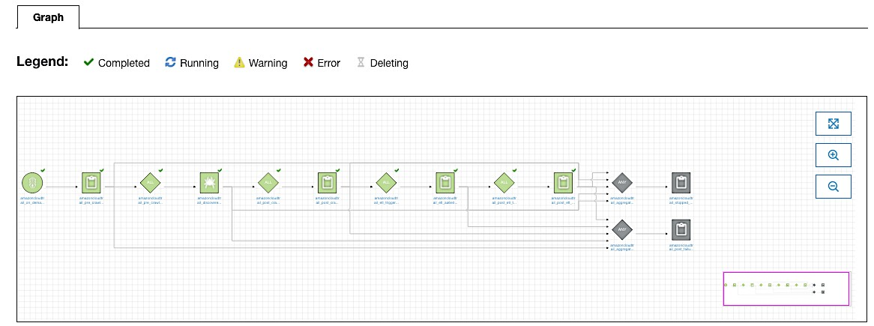
Blueprints create AWS Glue workflows

Slide 15
Securing data lakes with Lake Formation
Ingestion & cleaning
Security
Analytics & ML
Data
Serverless Spark
Data catalog
Comprehensive portfolio of integrated tools
AWS Glue
Centralized permissions
Glue ML transformations
Real time monitoring
Blueprints
Integrated auditing

Slide 16




Data Catalog & Permissions
Permissions are set on data catalog objects
Lake Formation & AWS Glue use the same Data Catalog
Data Catalog
Choice of using the Glue or the Lake Formation permissions system
For backwards compatibility, the default settings enable the Glue permissions system
Existing Glue crawlers, jobs, triggers and workflows will not change
Crawlers
Workflows
Existing access to Glue resources will still be governed by IAM & S3 policies
Access Control

Slide 17
Upgrading to the Lake Formation permissions model
Not using the Glue Catalog? Using the Glue Catalog?
Change the default settings to start using the Lake Formation permissions system
Explicitly upgrade each data location, database and table when ready
Understand existing policies / access / usage
Configure corresponding Lake Formation policies
Remove the Glue permissions system by changing the default settings
Turn on the Lake Formation permissions system by registering the location

Slide 18







Centralized permissions
1. Administrator sets up user permissions on lake resources: databases, tables, and columns
Lake Formation
Redshift
Glue
Access Control
Data Catalog
3. Lake Formation authorizes access to resources
Data
2. User access data via integrated services
Amazon S3 Data Lake Storage
EMR
Athena

Slide 19
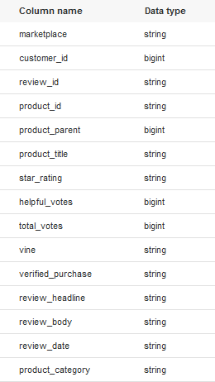


Security permissions in Lake Formation
Control data access with simple grant and revoke permissions
Specify permissions on tables and columns rather than on buckets and objects
User 2
Easily view permissions granted to a particular user
Audit all data access in one place
User 1

Slide 20
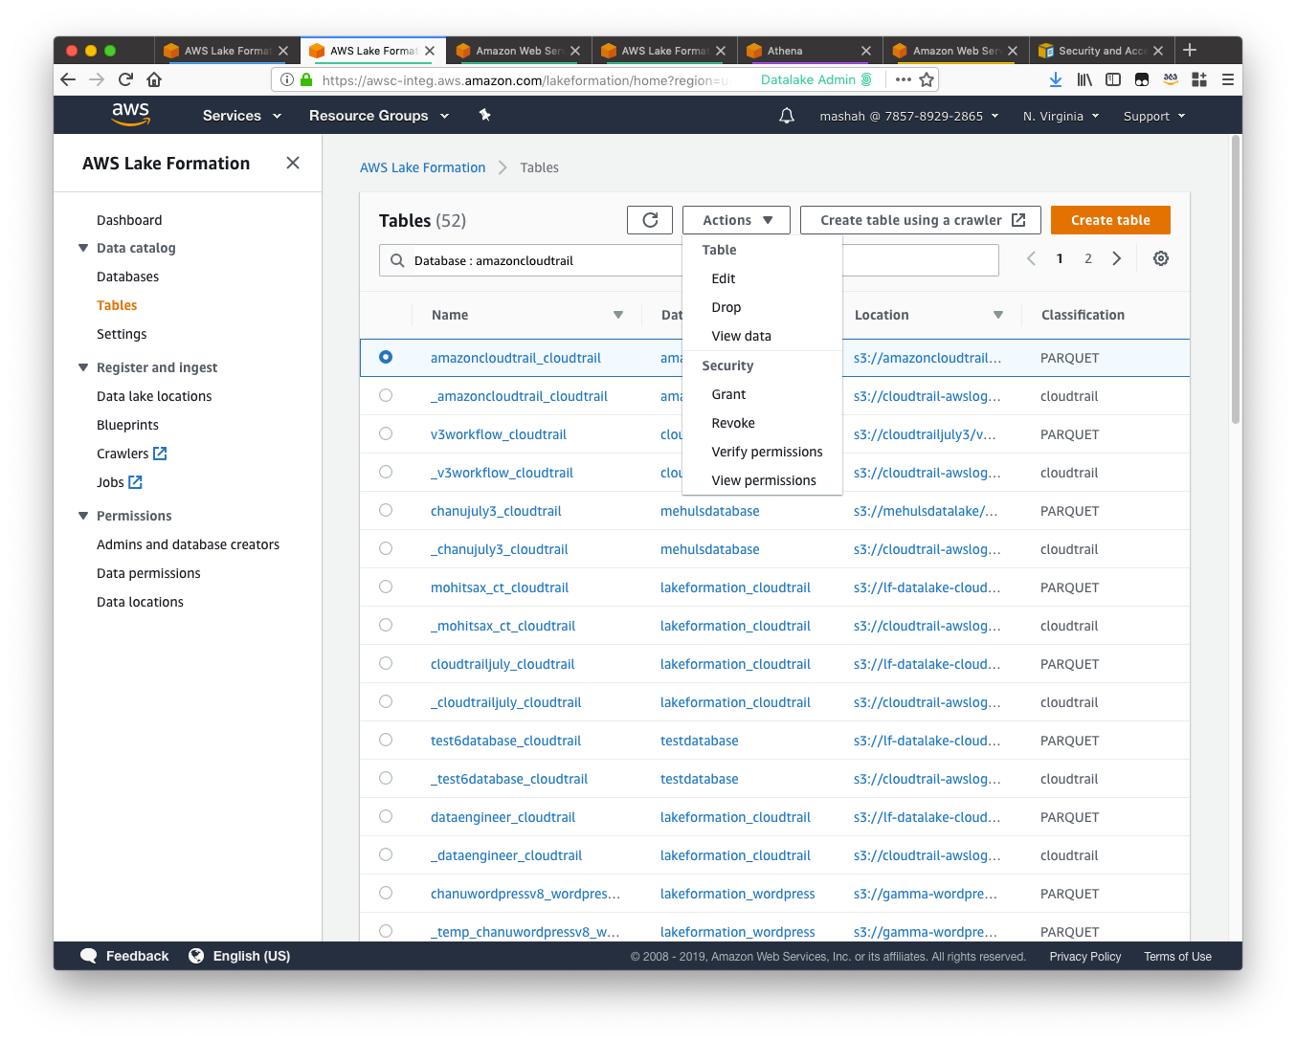




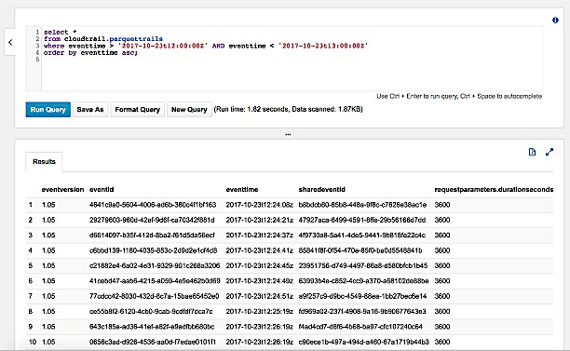




Data catalog and metadata management
Text-based search
all metadata
Add attributes like data owners, stewards, and others as table properties
Query data in Amazon Athena
Text-based search and filtering
Add data sensitivity level column definitions and others as column properties

Slide 21

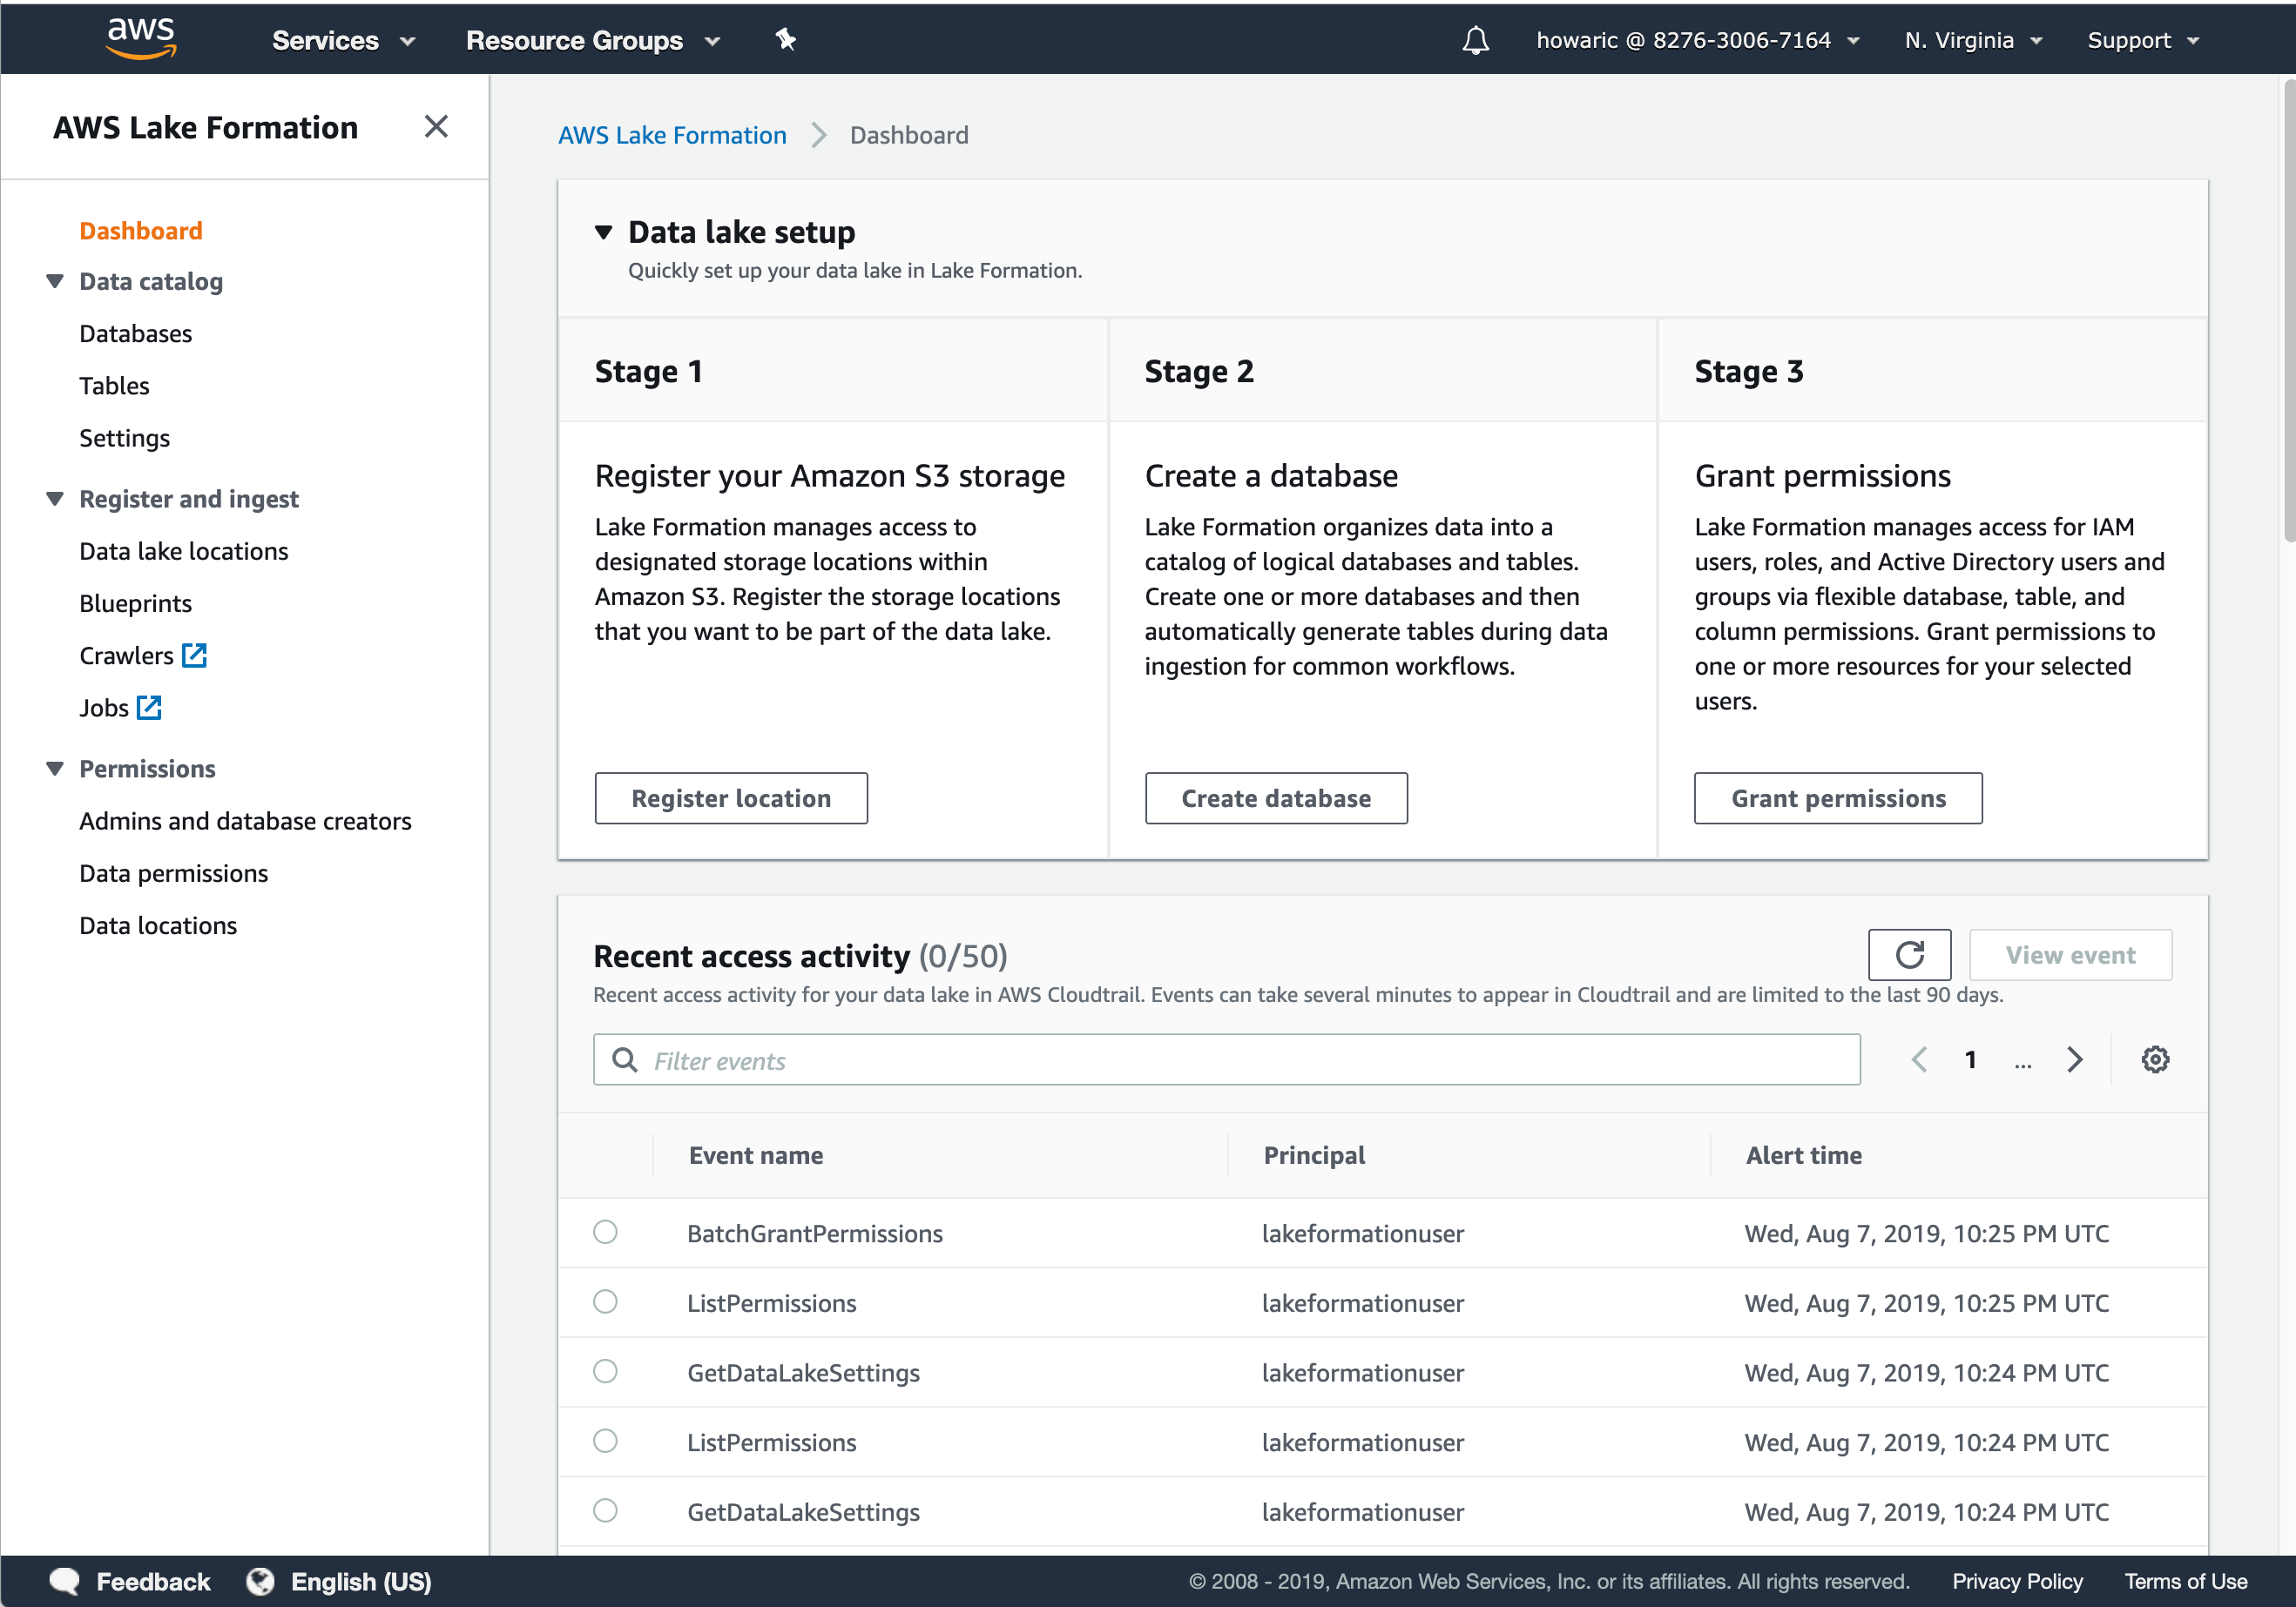
Audit and monitor in real time
See detailed activity in the console
Analyze audit logs in CloudTrail using Amazon Athena
Detailed activity
Data ingest and catalog notifications also published to Amazon CloudWatch events

Slide 22
Accessing data lakes with Lake Formation
Ingestion & cleaning
Security
Analytics & ML
Data
Serverless Spark
Data catalog
Comprehensive portfolio of integrated tools
AWS Glue
Centralized permissions
Glue ML transformations
Real time monitoring
Redshift
Glue
Blueprints
Auditing
EMR
Athena

Slide 23
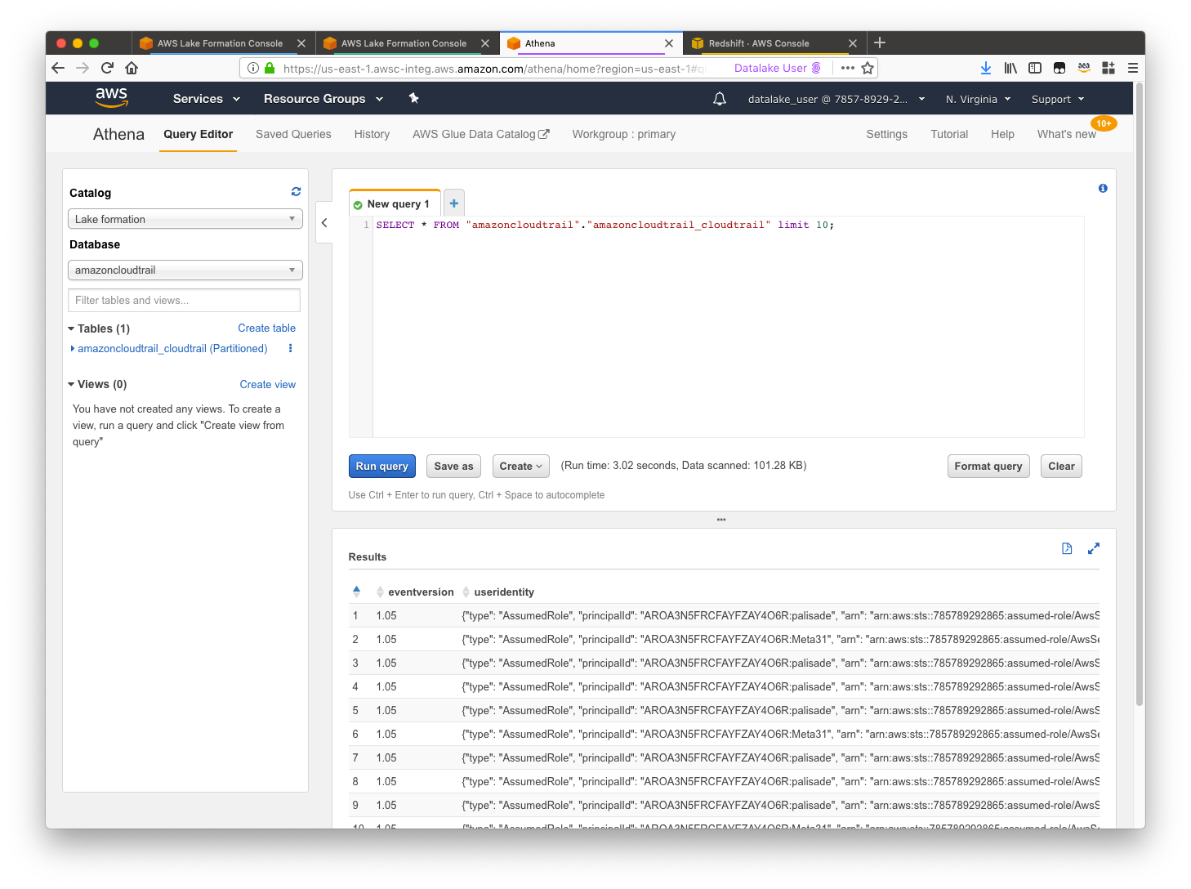




Comprehensive portfolio of integrated tools
Compliant services honor Lake Formation permissions
Amazon Redshift
Amazon EMR
AWS Glue
Amazon Athena
They guarantee that users only see tables & columns
All access is logged and auditable

Slide 24






















Serverless Lake Formation for Financial Services
On-premise
Region
Ingest
Transform
Analyze/Visualize
Lake Formation
Blueprints
ML
Transformations
Enhanced
Enhanced
Glue Catalog
Databases
Glue ETL job
(JDBC/ODBC) Glue Crawler
Glue Crawler
Glue Crawler
Files
Raw layer
Glue ETL job
Processed layer
Glue ETL Consumption job layer
Amazon Athena
Amazon QuickSight
Vendors
EC2 instances (SFTP)
Files

Slide 25
How It Works
Console Walkthrough

Slide 26
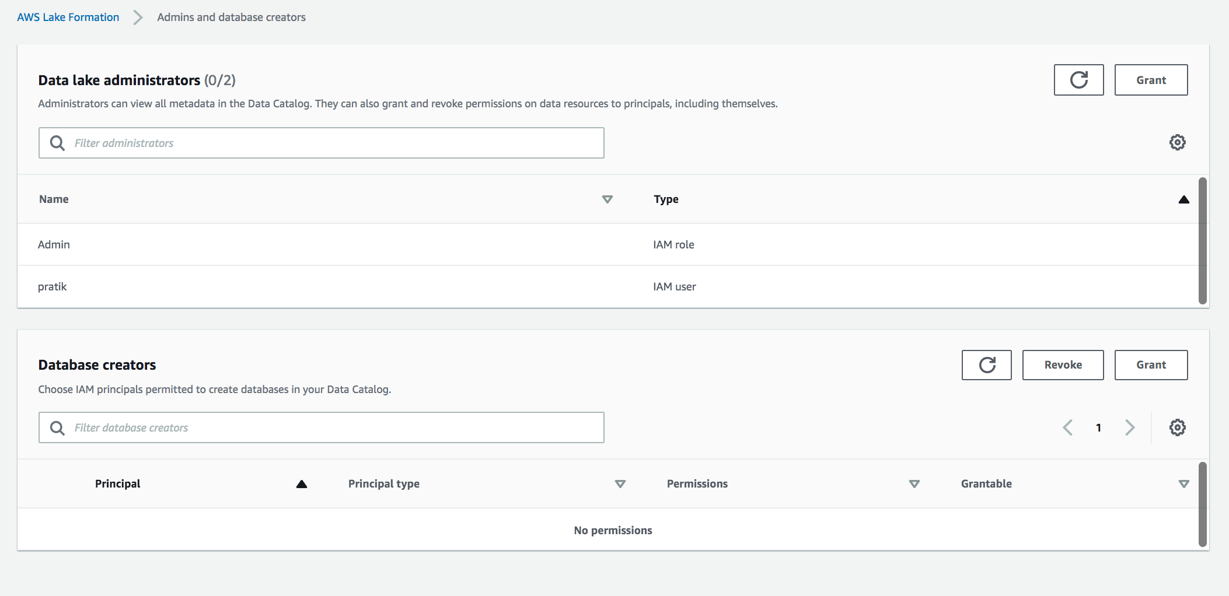
Step 1: Create a data lake administrator
A user who can create databases and tables in the data catalog and grant fine- grained permissions for other users

Slide 27
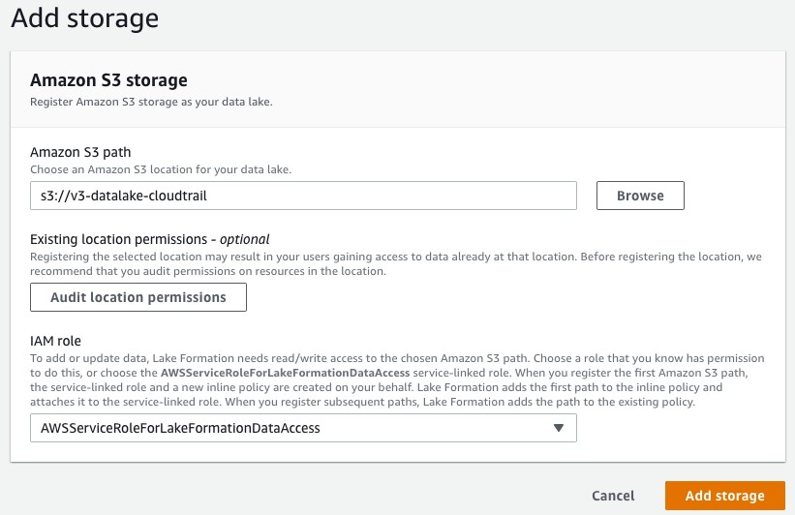
Step 2: Register S3 path as data lake location

Slide 28
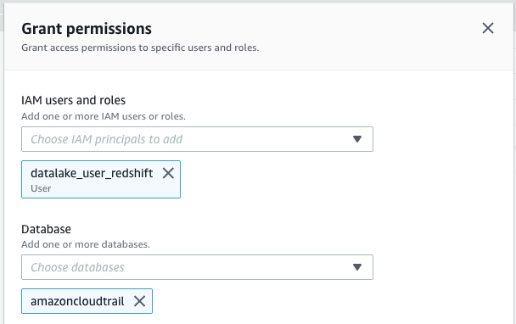
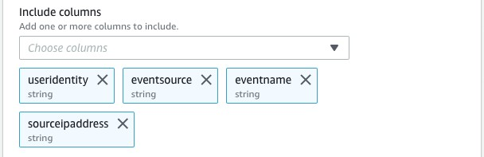


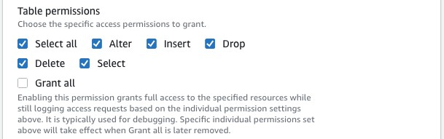

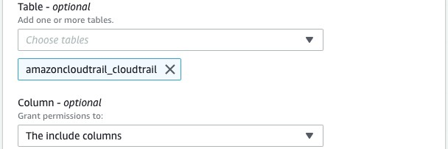
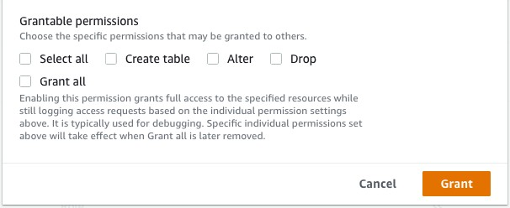
Step 3: Grant permissions to users at tables and columnar level
Data Analyst

Slide 29
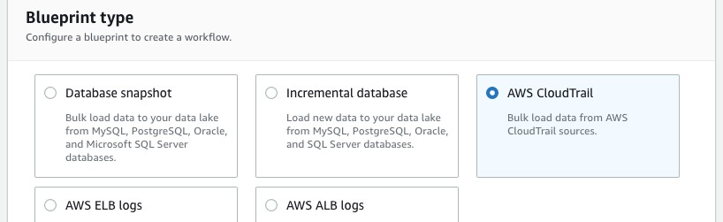
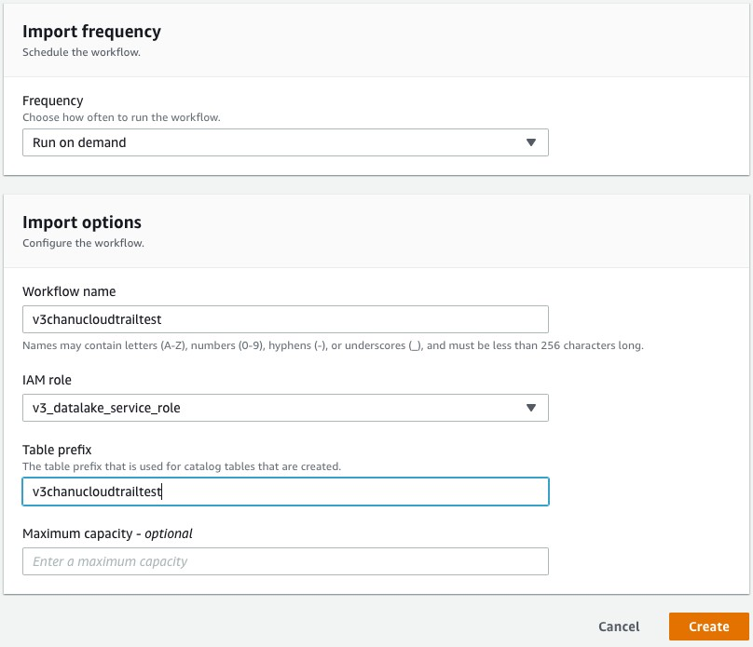
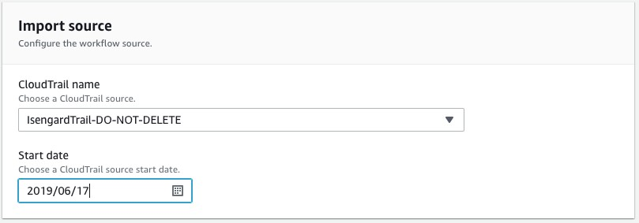
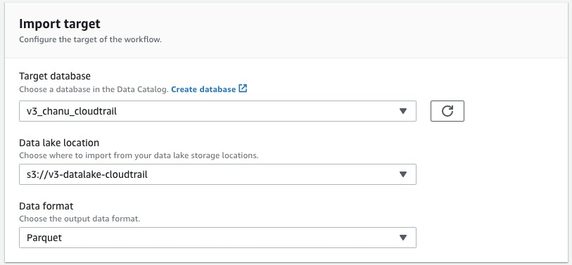
Step 4: Load data with blueprints

Slide 30
Step 5: Query data with compatible services
Data Analyst

Slide 31
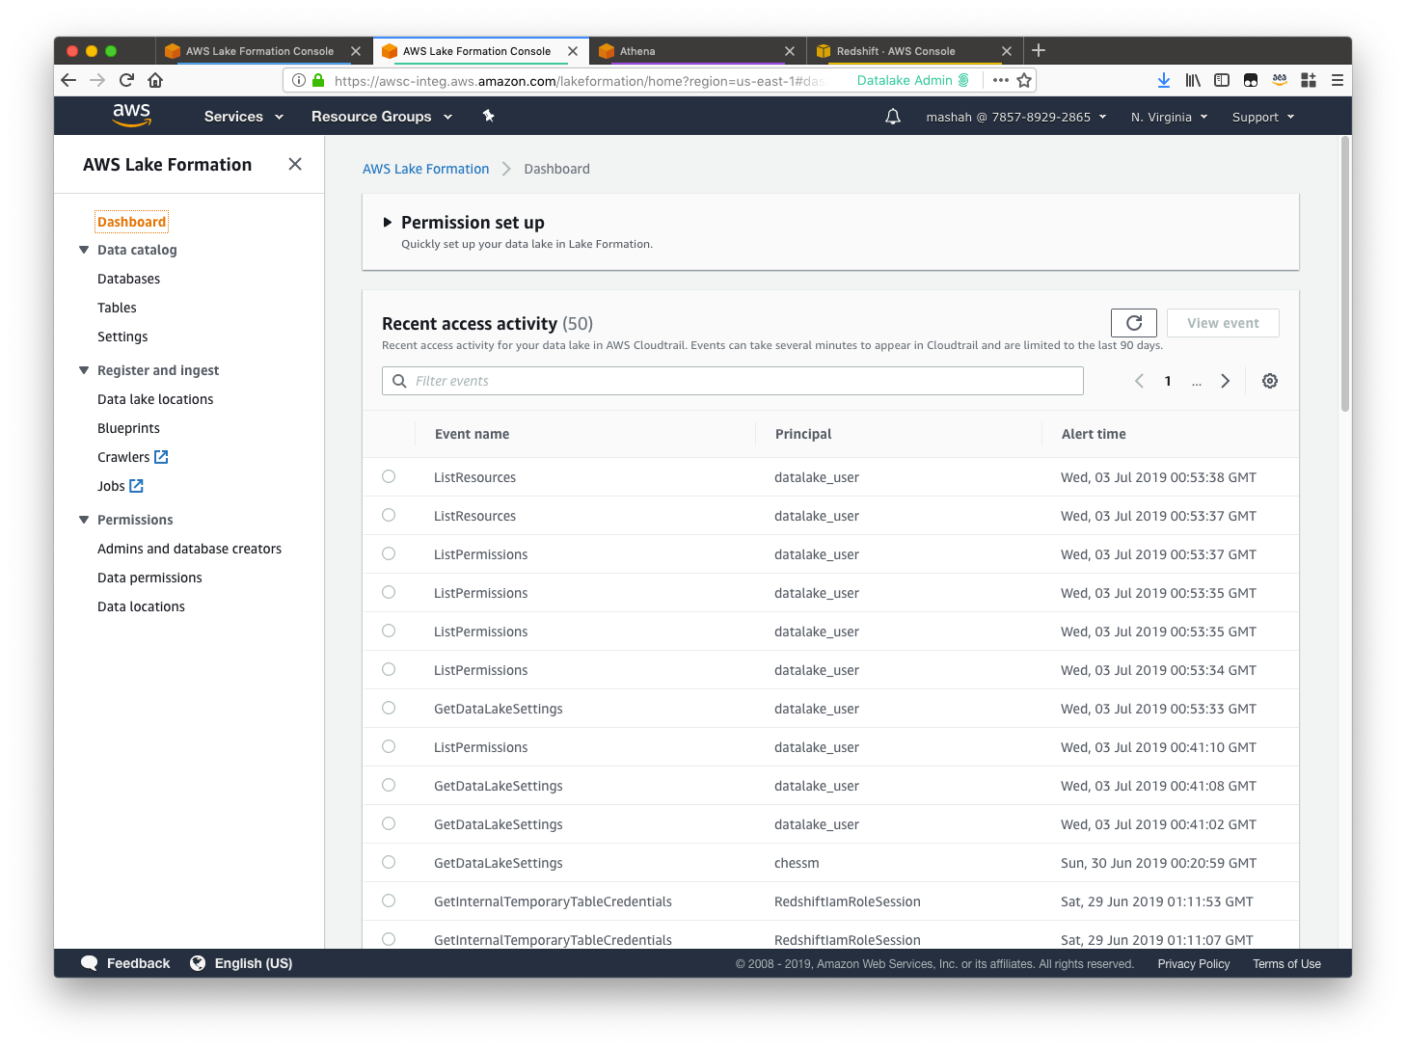

Step 6: Audit and monitor in real time

Slide 32
Thank you!

